Slide 1
Building Apps with Web AppBuilder
Patrick Hammons

Slide 2

Agenda
Product overview
Web AppBuilder for ArcGIS tour
Web AppBuilder: Developer Edition
Building apps with Web AppBuilder (Hands-on)
Community and Resources

Slide 3

The ArcGIS Platform enables Web GIS
Enabling GIS Everywhere
Desktop
Web
Device
Simple
Integrated
Open
portal
Server
Online Content and Services
Available in the Cloud . . . . . . and On-Premises
A

Slide 4
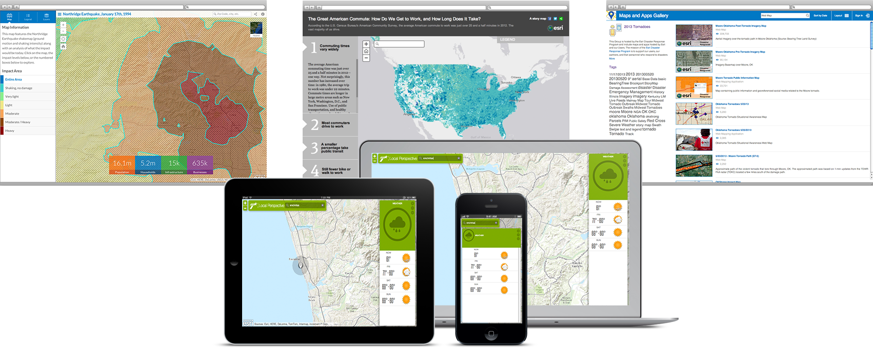
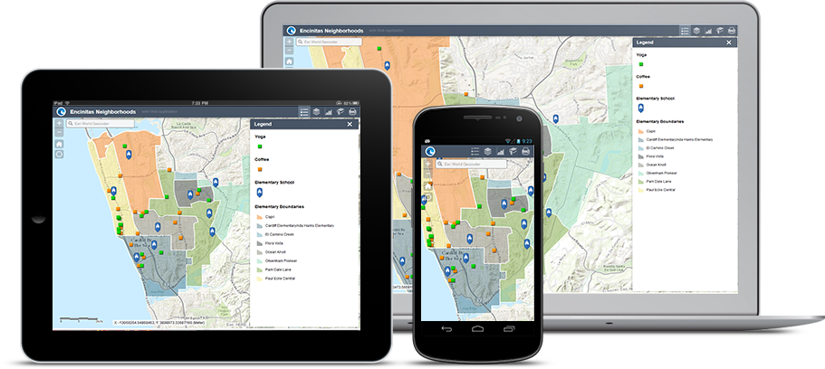
Creating web apps with ArcGIS
Notes:
@ esri work hard to make it easier to buid and deploy apps
Listen to your feedback
Some orgs don’t have developer resources to build custom apps
Give you better tools to deploy apps
Today focus = web apps

Slide 5
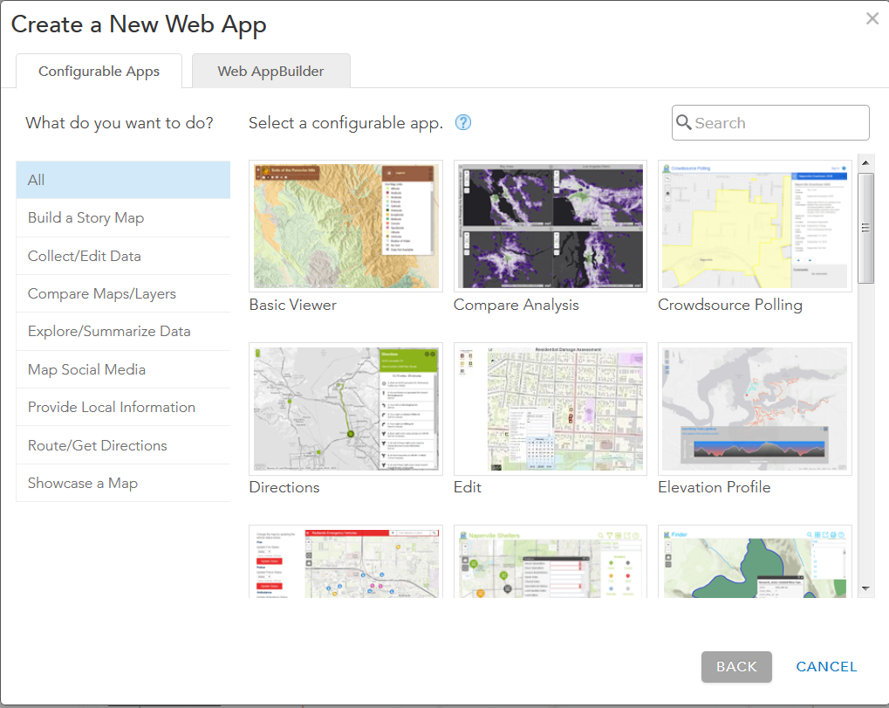
ArcGIS Configurable Application Templates
ArcGIS Online and Portal for ArcGIS
Web Map
Notes:
How does it start? – with a web map
Create in ArcGIS Online, Portal for ArcGIS, Desktop (pro)
Web map = starting point
Build and deploy web application around it using config template
Templates are focused
Take web map - with your data – and bring it into the template
Then config – change color, add logo, change title
Template – easy to use – designed for specific workflows
Ex: editing, compare data, data changes over time
But heard from users – want more functionality – mix functionality together from various templates…

Slide 6
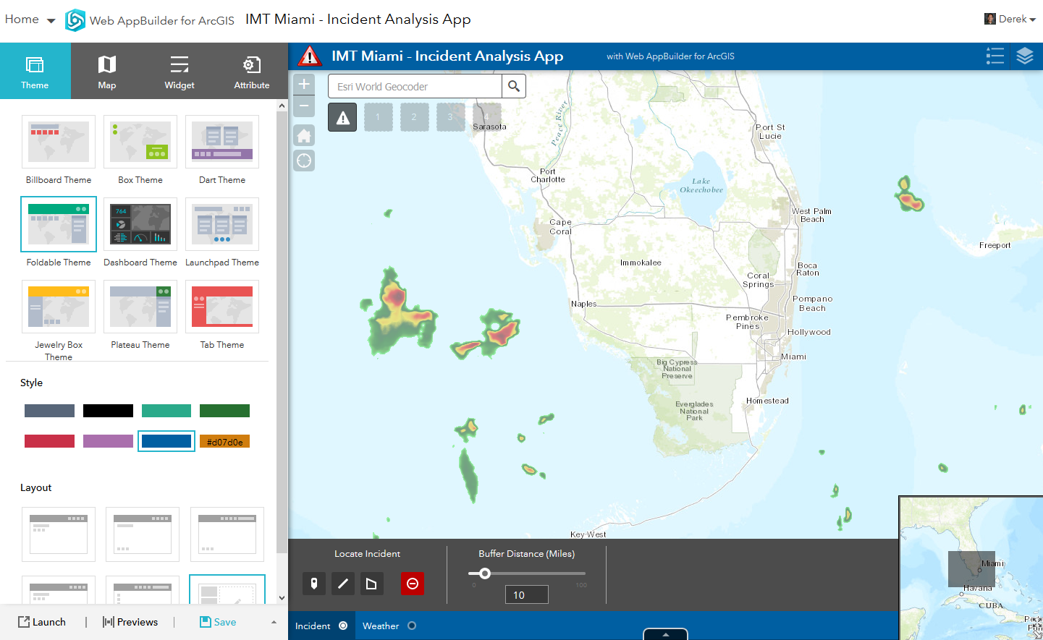
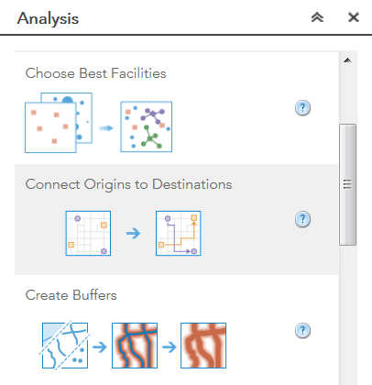
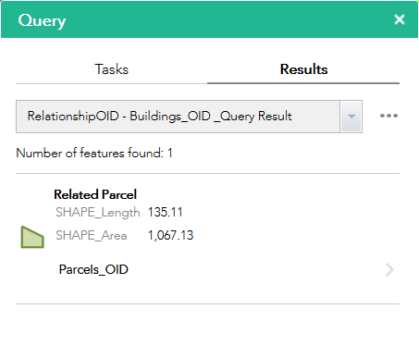
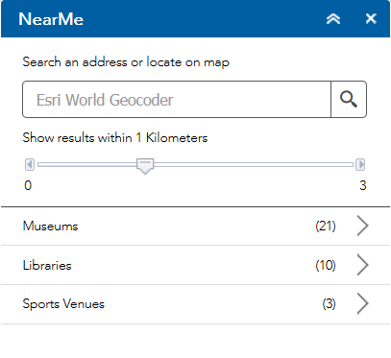
Web AppBuilder for ArcGIS
40+ widgets
Create new web apps without programming
Notes:
That’s where WAB for ArcGIS Comes in
Powerful
Re-purpose for variety use cases/workflows
You as app builder can choose functionality, data, and easy to configure great looking user experience
40+ widgets to choose from and continually adding

Slide 7

Web AppBuilder for ArcGIS
Functionality within ArcGIS Online and Portal for ArcGIS
ArcGIS Online since Dec 2014
Portal for ArcGIS in 10.3 and later
Enables new apps to be created without coding
Interactive WYSIWYG user experience
Supports 2D and 3D apps
2D apps runs on any device, in a web browser
Fully integrated with the ArcGIS Platform
Built with ArcGIS API for JavaScript and HTML 5 technology
Extensible
Notes:
WHAT IS IT?
Build new web apps without writing single line of code
Available – agol and portal for arcgis – component of arcgis enterprise
Supports 2D and 3D content
Built with ARCGIS API for JS – developer write custom code to create custom functionality – build your own widgets
OR - download app code – make changes
OR – use dev edition

Slide 8
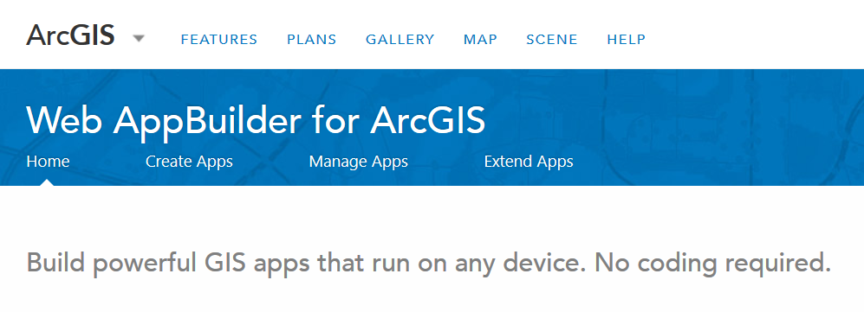
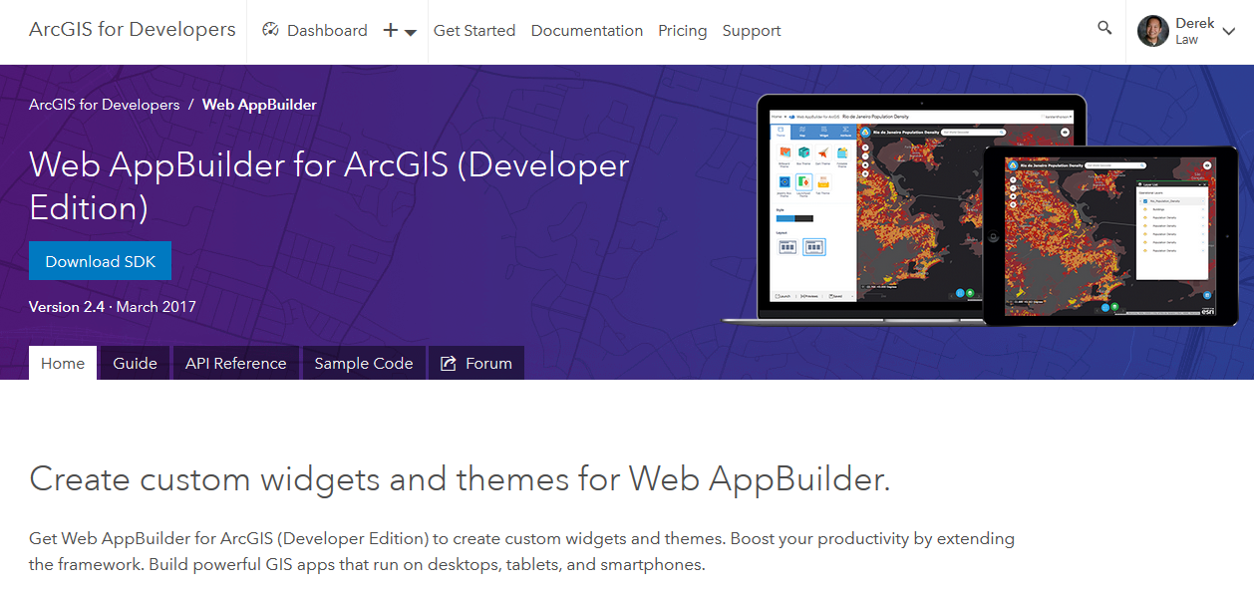
2 Options to Work with Web AppBuilder
Within ArcGIS Online or Portal for ArcGIS
Embedded in the web site
Activate from the map/scene viewer or Content page
Developer Edition
Separate download and installed locally
Sign into ArcGIS Online or Portal for ArcGIS
Support for custom widgets and themes
Both offer the same “builder” user experience, same capabilities
Notes:
2 options to work with WAB
Within ArcGIS Online or Portal for ArcGIS – we’ll walk through creating and using in AGOL today
Developer edition – customization
No matter what option you choose – user experience is same

Slide 9
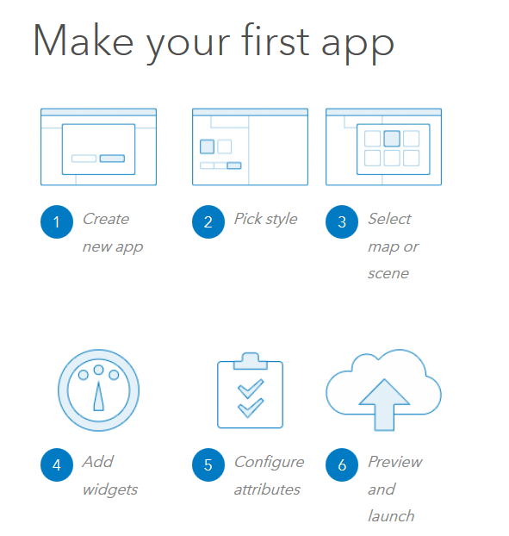
Workflow for Creating a new App
2D or 3D
Notes:
How get started> - really 3 easy steps:
Specify data
Look and feel – appearance
Functionality
Let me show you an example of a configured WAB

Slide 10

Web AppBuilder: Widgets

Slide 11
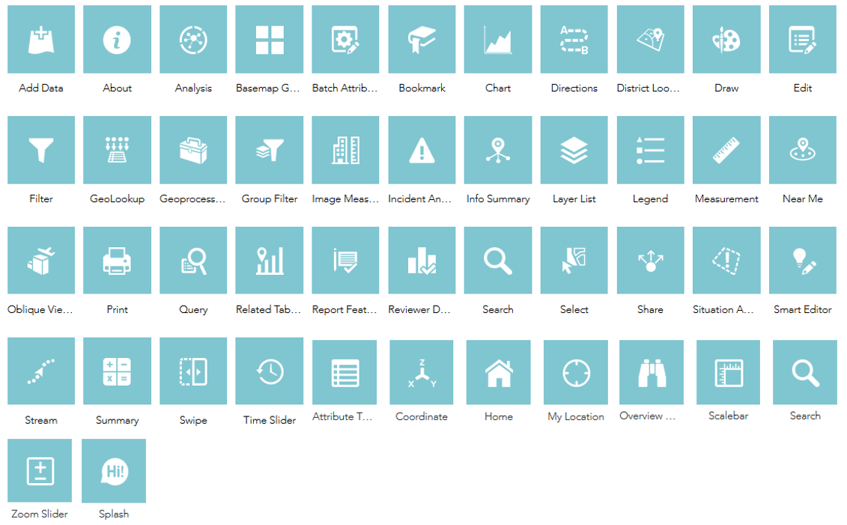






Available Widgets for 2D Web Apps
Widget: provides a specific functionality with configuration options
40+ available; enable core web mapping application capabilities
Notes:
40+ widgets – team always adding functionality and looking for feedback on enhancing current widgets and ideas for new ones
Separate into 2 groups…

Slide 12

Foundation Widgets
Navigation
Query
Search
Geocoding
Editing
Geoprocessing
Printing
Legend
Layer List
Overview Map
Attribute
Add Data
Select
Notes:
Core Widgets
Build GIS app = typical capabilities
Editing
Querying
Bring in geoprocessing tool from server and run in WAB

Slide 13
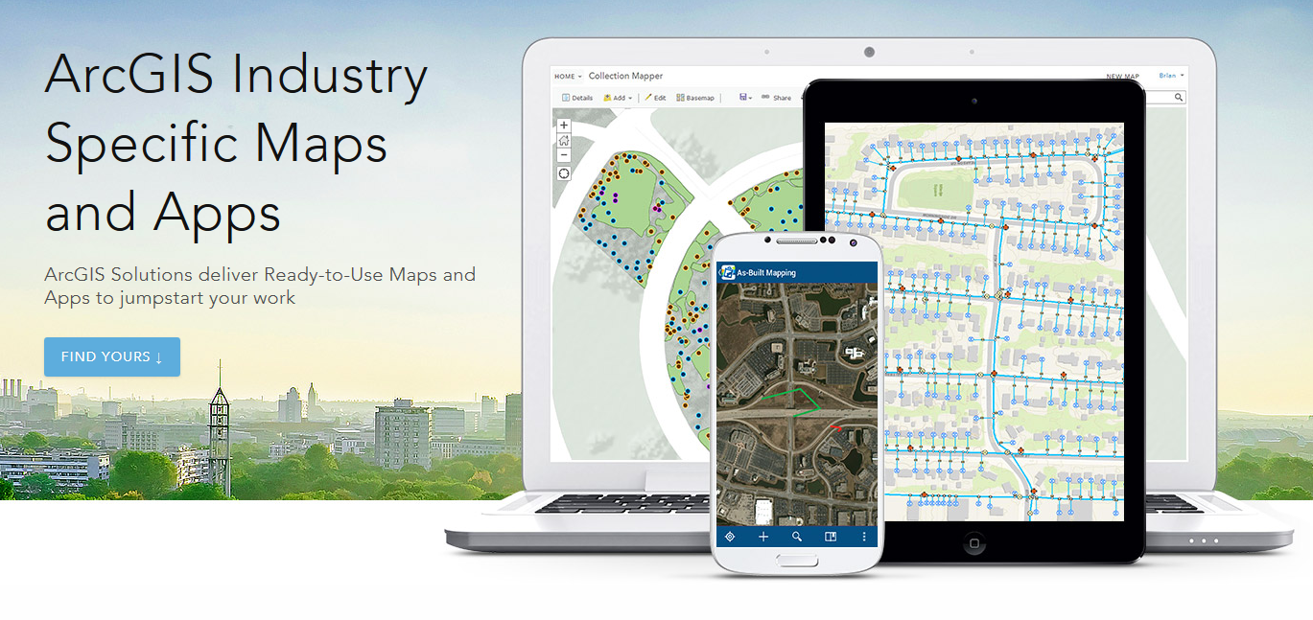
Solution Widgets
Batch Attribute Editing
Grid Overlay
Group Filter
Info Summary
Near Me
Parcel Drafter
Reviewer Dashboard
Screening
Smart Editor
Suitability Modeler
Notes:
Solution Widgets – built by esri solutions team
Deployed WAB to solve real world problems – found to be so useful for many people across industries that integrated functionality into core widgets
Example:
Parcel editing
Advanced editing, etc.

Slide 14
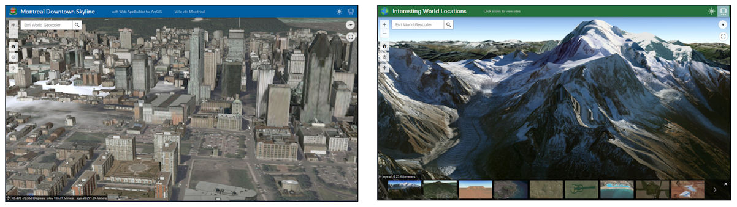

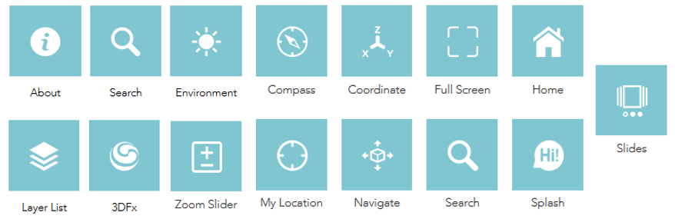

Available Widgets for 3D Web Apps
3D enabled widgets
Some widgets rebuilt to work with 3D content
Notes:
Mentioned – WAB also supports 3D content, in addition to 2D
- Select set of 3D widgets, team adding more as 3D capabilities grow within ArcGIS Platform

Slide 15


Use Web AppBuilder Developer Edition for Customization
Notes:
Let’s talk about Developer Edition of WAB

Slide 16


2 Tiers of Customization
Enabling custom functionality – Configurator
Add custom widgets to your apps
Non-developer
Extending custom functionality – Developer
Create new widgets from scratch
Programmer
Notes:
2 personas that use developer edition:
Not a developer – you’re probably in first group = configurator
Take custom widgets and leverage in developer edition
If you’re a developer & write custom code using ARCGIS API for JS – can create widgets from scratch

Slide 17
Web AppBuilder Developer Edition
Developers.ArcGIS.com/web-appbuilder
Download and install locally
Sign into ArcGIS Online or Portal for ArcGIS
Same “builder” user experience as embedded Web AppBuilder
Provides extensibility framework for apps
Leverages ArcGIS API for JavaScript
Notes:
Developer edition = 2nd option for work with WAB = separate download
- From developer.arcgis.com

Slide 18

Community and Resources
Notes:
What makes WAB successful is active user community

Slide 19




GeoNet – Esri Community
3 places for Web AppBuilder user community
Top GeoNet contributors post in these forums
Notes:
3 forums on geonet – very active
WAB forum
Custom widgets forum
Custom themes

Slide 20
Web AppBuilder for ArcGIS Resources
Online help documentation http://doc.arcgis.com/en/web-appbuilder/
Developer Edition help documentation https://developers.arcgis.com/web-appbuilder/guide/xt-welcome.htm
Esri Live Training Seminar: Get Started with Web AppBuilder for ArcGIS (60 mins)
Esri Web course: Creating Web Applications Using Templates and Web AppBuilder for ArcGIS (2-4 hours)
Notes:
Last few resources

Slide 21



